Slide 1


Headstart to Programming

Slide 2

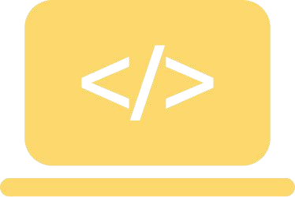



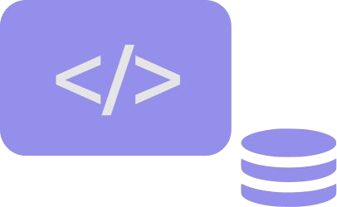
Topics for the Day
Introduction to programming
Introduction to Javascript
Why use JavaScript
Intro to Mozilla Firefox multi-line console
Hello World Program in Javascript
console.log()

Slide 3



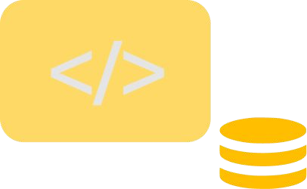

Topics for the Day
Variables
Operators
Coercion
Data types
Comments

Slide 4
Introduction to programming
Programming is a way to write tasks to be performed by the computer. A program can be written in a programing language.
Many programming languages like C, C++, Javascript, Python, Java, etc. Each language has its own rules, following which we need to write a set of instructions that the computer can perform.
Programming tasks could be as simple as adding two numbers and writing complex algorithms that help rockets land on the moon.

Slide 5
Introduction to Javascript
Simply put, Javascript is a programming language that helps you write instructions that a computer, to be more speciﬁc, a browser can understand.
Javascript was primarily used to be executed on browsers, but then NodeJS was created, which can help execute Javascript on your machine outside the browser.
Javascript is a single-threaded, synchronous, high-level programming language.

Slide 6
Let’s understand the previous statement clearly.
Single-threaded means that a javascript program cannot be broken into sub-programs and execute the sub-programs parallelly. Understand the entire program as rope and a sub-program as a thread of the rope.
Synchronous means that the order of execution will always happen sequentially; the program can’t skip some lines of code and come back to it later. But that being said, we can perform asynchronous tasks in javascript using web APIs; we’ll learn about this later
High-level programming language means that it is more human-readable and understandable and less machine-understandable.

Slide 7

History of Javascript
JavaScript was invented by Brendan Eich in 1995. He was recruited by Netscape to develop a language which can be run in the browser.
In 1996, Microsoft released their own version of Javascript and it was named as JScript. To prevent this conﬂict, Netscape went to the European Computer Manufacturers Association, aka ECMA to develop standard Javascript. They standardized Javascript and renamed it as ECMAScript, since it was developed by them.

Slide 8
Why use Javascript
Why should you learn javascript? Well, there are a few reasons for that.
A program will always be in javascript on the front-end that is the UI of any website. The browser understands only HTML, CSS, and Javascript.
Now, there are languages like GWT(Java), dart, etc., using which we can create UI, but those languages translate the code into javascript, and then the javascript code gets executed on the browser.

Slide 9
So why not write your code in javascript itself, you’ll save time that takes to convert any language to javascript and also you’ll have more control over the code.
Another reason is that once you learn javascript you can become a full-stack developer without the need to learn any other language.
Also, Javascript is used to create Desktop apps with Electron and React native desktop frameworks. And Javascript is also used to create android and IOS apps using React native.

Slide 10
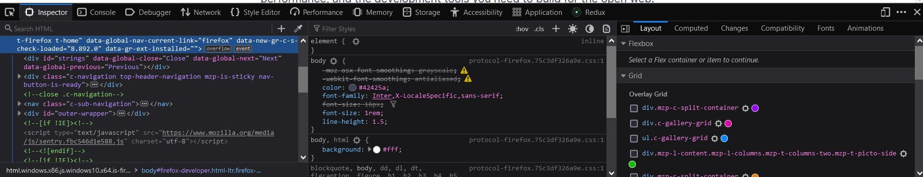
Mozilla Firefox multi-line console
Firefox provides a multi-line console where you can write and execute your javascript code without the need for a code editor.
To use it, ﬁrst download ﬁrefox from here and install it in your system.
Open the Firefox browser and press ‘F12’ OR right-click and click on inspect. You’ll see the dev tools window open like below

Slide 11
First, click on the ‘more options’ icon ( top-right corner ) besides the ‘close’ icon and choose the ‘separate window’ option. Now your dev-tools window will be open in a separate window.
Select console tab.
On the left side, we have the code panel and right side we have the console. You can write your javascript code on the code panel and click on ‘Run’ and the output will be shown on the console on right.
Your window will look like below

Slide 12
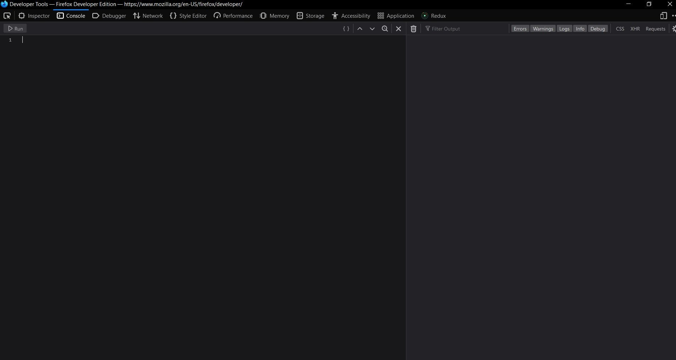

Slide 13
Understanding function
A function is a block of code which can perform some task. It takes some input, applies some logic on it and gives the output.
INPUT
FUNCTION
OUTPUT
PROCESSING

Slide 14
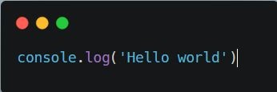
Writing an executing ﬁrst program: Hello World
Usually, when we learn a new programming language we always start by executing a ‘hello world’ program in it. So, let’s do it with Javascript too.
Write the following line of code in ﬁrefox code panel
And click on ‘Run’
You should see ‘Hello world’ on your console.

Slide 15
Awesome, you just ran your ﬁrst code in javascript. Now let’s understand the line of code.
‘console.log()’ is a function that helps you print any data on the browser console or on your terminal window if you are executing the javascript code in nodejs.

Slide 16
Understanding console.log()
Diving deeper into ‘console.log()’, ‘console’ is an object that provides access to the browser's debugging console. And ‘log’ is a method in console object that will print whatever string you pass as an argument to it. Now, I know there are many terms here that you might not understand like what is an object, what is a method, what do you mean by argument. These you’ll understand as and when you proceed with the coming sessions. But for now, just remember what is ‘console.log()’

Slide 17
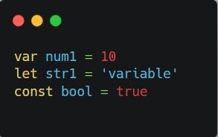
Variables
In order to store values like numbers, words, objects, etc we need variables. Variables are placeholders for values.
Every language has speciﬁc keywords to declare variables.
In Javascript, you can create variables using any of the following keywords

Slide 18
When we declare a variable we name it like ‘num1’, ‘str1’, ‘bool’ in the above value.
And also we assign a value to it to be stored in the variable. So that we can use it later in our program when needed.
Let’s try to understand variables in-depth, when we declare a variable the system memory reserves a memory location and stores the value assigned to it in that memory space. And when we reference the variable name again in the program, the value is fetched from that memory space.

Slide 19
Let’s understand the diﬀerence between var, let, and const
When we declare a variable with ‘var’ keyword, it is function-scoped
When we declare a variable with ‘let’ keyword, it is block-scoped
When we declare a variable with ‘const’ keyword, it is block-scoped, but we cannot re-assign the value. The value with which we initialise the const variable will remain constant throughout the program.
We’ll learn about function-scope and block-scope in later sessions

Slide 20
var | const | let
Globally scoped or function scoped. This means that the scope of variables deﬁned by this keyword can be either in the complete program or inside the complete function where we have deﬁned it. | These variables cannot be redeﬁned again or reassigned again. Once deﬁned, their values will be constant | These variables’ scope remains under the block.
var a; a=5; | const a = 5; a = 6; //error: Assignment to constant variable | { var a = 2; let b = 3; console.log(a); // this will print 2 console.log(b); // this will print 3 console.log(a); // this will print 2 console.log(b); //this will print undefined
These can be declared without being initialized | These cannot be declared without being initialized | These can be declared without being initialized

Slide 21

Comments in Javascript
Comments are basically textual information in your code that is ignored by the compiler and is used to communicate information about the code.
Commenting your code is a good practice for others to understand what your code does. For single-line comments use ‘//’
For multi-line comments use ‘/*....*/’

Slide 22
Data types
There are seven primitive data types and an object data type.
Number: used to represent numbers including negative, positive and 0
String: used to represent textual data
Boolean: values are ‘true’ and ‘false’
Null: value is ‘null’, represents the intentional absence of any object value.
Undeﬁned: value is ‘undeﬁned’, represents value as uninitialised
BigInt: The BigInt type is a numeric primitive in JavaScript that can represent integers with arbitrary precision.
Symbol: A Symbol is a unique and immutable primitive value and may be used as the key of an Object property

Slide 23
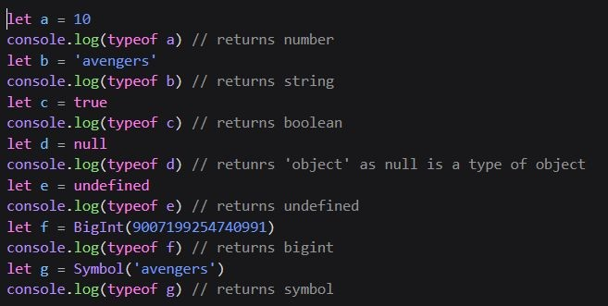

Slide 24
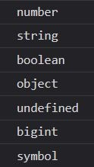
OUTPUT:

Slide 25
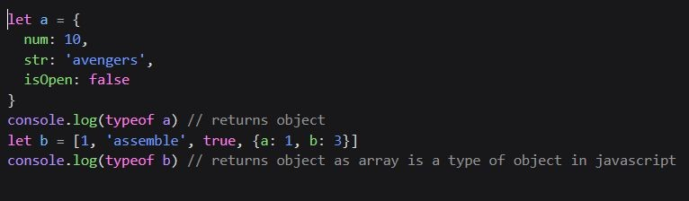
An object is a special data type that contains a series of key-value pairs.
An array is also a special type of object that contains a list of values; it can contain values of all data types, including objects

Slide 26

OUTPUT:

Slide 27
Numbers
Numbers are collections of diﬀerent digits. They can be integers or decimal numbers.
There are diﬀerent types of numbers like integers, decimal numbers, exponential numbers, special numbers like Inﬁnity, NaN and so on.
Example –
1. var num = 123; //Integer
2. var num = 212.13456
console.log(num.toExponential(4)); //toExponential function is used to write numbers.
Output -> 2.13e+0
We can directly write numbers in exponential form too. For example0 var num = 2.13e+10;
exponential

Slide 28
Numbers
3. Special numbers like Inﬁnity and NaN are kind of error values.
NaN
When any operation got failed or parsing failed, we get NaN as error Number(‘Hello’)
Output -> NaN
In the above code, Number() is a function to get the number value of argument passed. Here we passed ‘Hello’ which is a string and cannot be parsed. hence we got NaN as output
Inﬁnity
When number value is too large or it is divided by zero, we get Inﬁnity as output
a = 3/0
console.log(a)
Output -> Infinity
a = 3/ -0
console.log(a)
Output -> -Infinity

Slide 29
Boolean
Boolean can be 2 values either true or false. Whenever we want to store a value whose value can be either true or false, we can use Booleans datatype to store it.
Example – let x = true;

Slide 30
Null and Undeﬁned –
“Null” and “undeﬁned” refers to null value or when we don’t assign any value to it. When we do not give value to a variable, it denotes undeﬁned. When we give an empty value to the variable, it will be considered null.
Example –
var a = null;
var b;
console.log(a) // print null
console.log(b) // print undefined

Slide 31
String –
A string is a collection of alphanumeric characters and symbols. To store diﬀerent words, letters, and sentences, we use strings. In JavaScript, we can either use single or double quotes to deﬁne it. We can also use backticks to deﬁne strings.
Example –
var str = “Hello World” // double quotes var str = ‘Hello World’ // single quotes var str = `Hello World` //backticks
var multillineStr= `Say hello to multi-line
string `;
Hello, World datatype is a string in the above example.

Slide 32
Operators
When we want to execute any operation like addition, subtraction, division, multiplication, etc in a programming language, we have to use ‘operators.’
There are various types of operators in javascript, Increment/Decrement operators: a++, --a,
Unary operators: typeof, +, ! Arithmetic operators: +, -, /, * Relational operators: >, <, >=, <= Equality operators: ==, !=, ===, !== Assignment operators: +=, -=, /=, *=

Slide 33
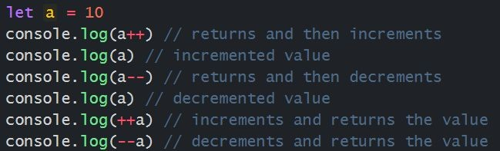
Increment/Decrement operators
The increment operator (++) increments (adds one to) its operand and returns a value.
The decrement operator (--) decrements (subtracts one from) its operand and returns a value.
If used postﬁx, with operator after operand (for example, x++/x--), the increment/decrement operator increments/decrements and returns the value before incrementing/decrementing.
If used preﬁx, with operator before operand (for example, ++x/--x), the increment/decrement operator increments/decrements and returns the value after incrementing//decrementing.

Slide 34

OUTPUT:

Slide 35
Unary operators
‘typeof’ operator returns the data type of the value
‘+’ operator attempts to convert a value into a number if it isn't already a number
‘!’ operator converts truthy values to falsy and vice versa

Slide 36
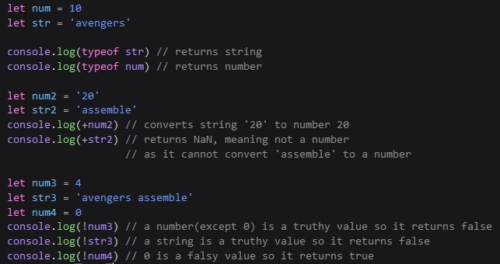

Slide 37

OUTPUT:

Slide 38
Falsy Values
The falsy values in javascript are 0, 0n(BigInt) , null, undeﬁned, NaN, false and “”(empty string). These values are evaluated as false by the javascript engine. Apart from these values, all remaining values are truthy values in javascript.

Slide 39
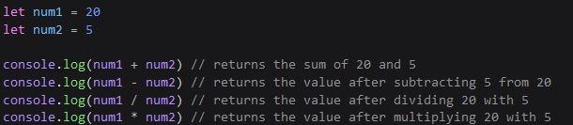
Arithmetic operators
These operators perform operations like addition, subtraction, division, multiplication, etc

Slide 40

OUTPUT:

Slide 41
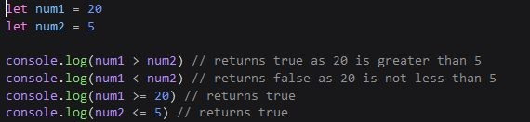
Relational operators
A comparison operator compares its operands and returns a boolean value based on whether the comparison is true.

Slide 42

OUTPUT:

Slide 43
Equality operator
‘‘!=’ operator (Inequality Operator) checks if two values are not equal. It will perform type coercion.
Example -
'1' != 1 -> return false
1 != 1 -> return false
‘!==’ operator(Strict Inequality Operator) will not perform type coercion before comparing two values.
Example -
'1' !== 1 -> return true
1 !== 1 -> return false

Slide 44
Equality operator
‘==’ operator checks abstract equality i.e. it will perform required type coercion before applying equality comparison. While ‘===’ operator checks strict equality i.e. it will not perform any type coercion. If two values are not equal, then it will simply return false.
Example -
9 == “9” -> return true (string “9” is converted to number 9) 9 === “9” -> return false ( no type coercion takes place here)

Slide 45
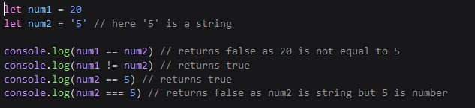
Equality operator
‘==’ and ‘!=’ checks if two values are the same or not
‘===’ and ‘!==’ are strict equality operator checks if two values are the same including the data types

Slide 46
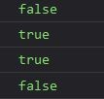
OUTPUT

Slide 47
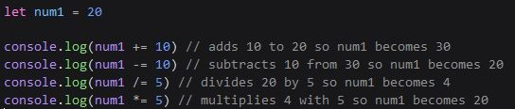
Assignment operators
‘+=’, ‘-=’, ‘/=’, ‘*=’ these operators perform the respective arithmetic operations and then assign the resultant values.

Slide 48

OUTPUT:

Slide 49
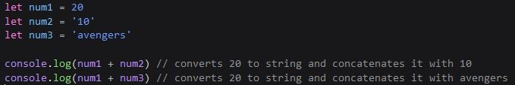
Type Coercion
Type coercion is the automatic or implicit conversion of values from one data type to another (such as strings to numbers).

Slide 50

OUTPUT:

Slide 51

Homework
Create a basic calculator program using Javascript
Use diﬀerent arithmetic operators and variables to show working of calculator

Slide 52

Upcoming Class Teaser
conditional Statements switch case
ternary operators
comparison between the diﬀerent conditional constructs loops/iterative Statements
for, while, do-while loops
comparison between the diﬀerent iterative constructs

Slide 53
Thank you

